Slide 1
Data structure and Algorithm Lesson 2: Effeciency
DII Summer 2021
By Aj.Suttinee

Slide 2
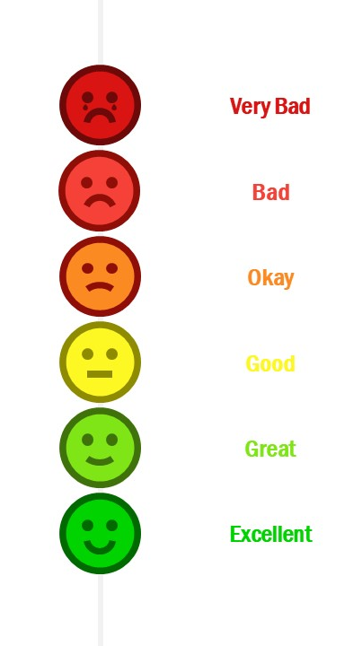
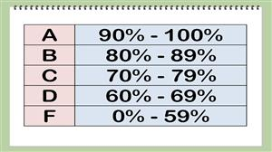
Effeciency ?
Multiple implementations of the same function
Write a method to receive an integer and sum the values from 1 up to the received integer
Notes:
https://stackoverflow.com/questions/958908/how-do-you-reverse-a-string-in-place-in-javascript

Slide 3
Objectives
Know how to discuss trade-offs between different approaches
Know how well our code perform
Can help you find the pain points in our approaches

Slide 4
Asymptotic notation
Theta
Omega
Oh

Slide 5
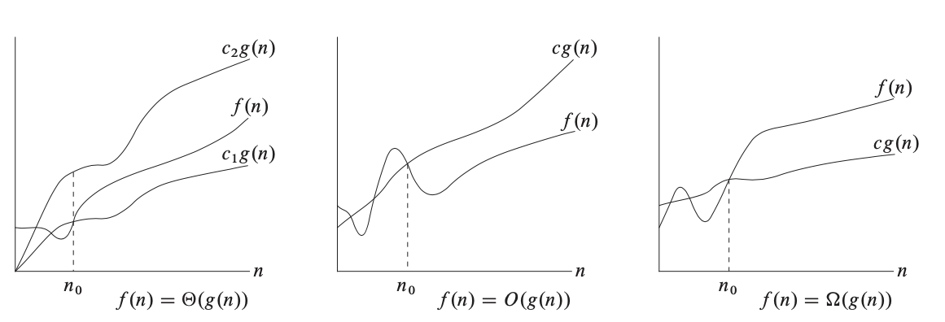

𝚯-notation (Big theta)
n denotes size or steps of the algorithm
$$f\left(n\right)=\frac{1}{2}n^{2} −3n$$
$$=θ(n^{2})$$

Slide 6
𝝮-notation (Big Omega)

Slide 7

O-notation (Big O, Big Oh)
$$f\left(n\right)=2n+3$$

Slide 8
Example
I want to know how well these code perform, what should I do ?
public static int multiply2ToTheEnd(int[] array) { int index = array.length -2; return array[index]*2; }
public static int sum(int[] array) { int sum =0; for(int i =0; i < array.length; i++) { sum = sum + array[i]; } return sum; }
Different machines will record different times
The same machince will record different time
For fast algorithms, speed measurements may not be precise enough

Slide 9
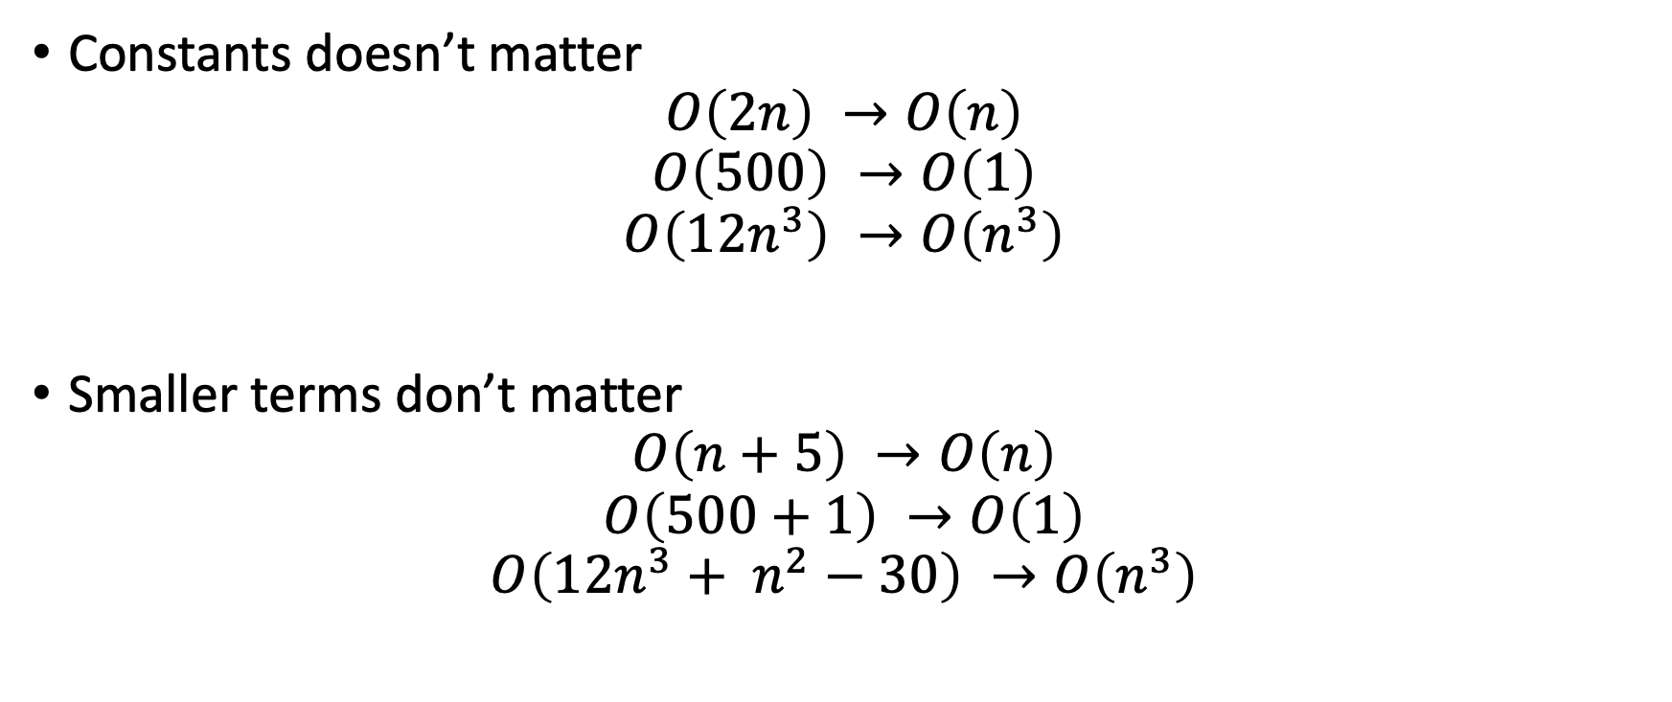
Tricks
Constants doesn’t matter
$$O\left(2n\right) →O\left(n\right)$$
$$O\left(500\right) →O\left(1\right)$$
$$O\left(12n^{3}\right) →O\left(n^{3}\right)$$
Smaller terms don’t matter
$$O\left(n+5\right) →O\left(n\right)$$
$$O\left(500+1\right) →O\left(1\right)$$
$$O\left(12n^{3}+ n^{2}−30\right) →O\left(n^{3}\right)$$

Slide 10
Shorthands
The following rules won’t always work, but are a helpful starting point
Arithmetic operations are constant time
Variable assignment is constant time
Accessing elements in an array is constant time
In a loop, the complexity is the length of the loop multiply by the performance inside of the loop

Slide 11
Let’s count the number of simple operations
public static int multiply2ToTheEnd(int[] array) { int index = array.length -2; return array[index]*2; }
1 assignment
1 substraction
1 multiplication
Approximately 3 operations

Slide 12
Let’s count the number of simple operations
1 assignment
n comparison
1 assignment
n addition
n addition
public static int sum(int[] array) { int sum =0; for(int i =0; i < array.length; i++) { sum = sum + array[i]; } return sum; }
n assignment

Slide 13
Let’s count the number of simple operations
1 assignment
n comparison
1 assignment
n substraction
n addition
Approximately 4n+2 operations
You can see that when the size of the input array grows, the number of operations increases accordingly.
Unlike the previous method ( multiply2ToTheEnd) , the number of operations does not influcenced by the size of the input array.
public static int sum(int[] array) { int sum =0; for(int i =0; i < array.length; i++) { sum = sum + array[i]; } return sum; }
n assignment

Slide 14

Big Oh
$$f\left(n\right)=3=O\left(1\right)$$
Proof
$$0≤3≤cg\left(n\right)$$
Let c = 3, we will get $0≤3≤3∗1$
public static int multiply2ToTheEnd(int[] array) { int index = array.length -2; return array[index]*2; }

Slide 15
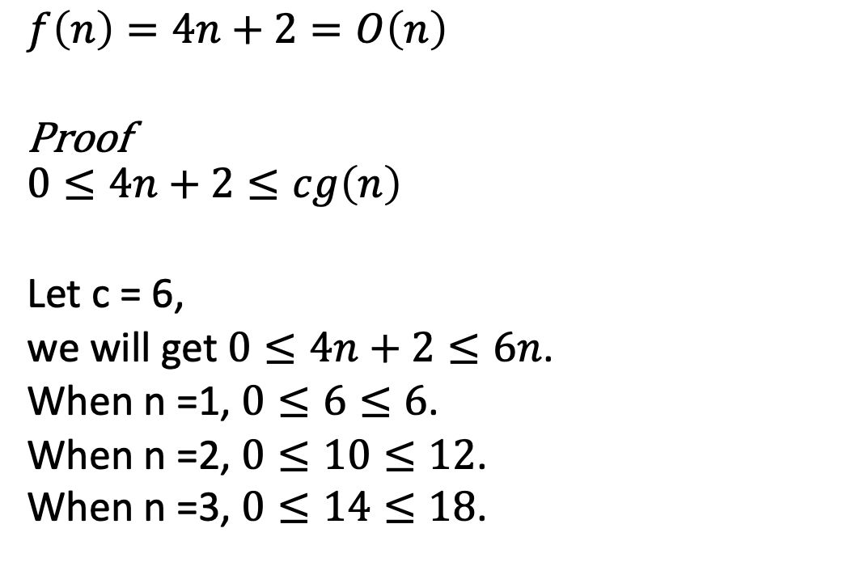
Let’s count the number of simple operations
$$f\left(n\right)=4n+2=O\left(n\right)$$
Proof
$$0≤4n+2≤cg\left(n\right)$$
Let c = 6,
we will get $0≤4n+2≤6n$.
When n =1, $0≤6≤6$.
When n =2, $0≤10≤12$.
When n =3, $0≤14≤18$.
1 assignment
n comparison
1 assignment
n substraction
n addition
public static int sum(int[] array) { int sum =0; for(int i =0; i < array.length; i++) { sum = sum + array[i]; } return sum; }
n assignment

Slide 16
Example
public static int addUpTo(int n) { int sum=0; for (int i=1;i<= n;i++) { sum = sum+i; } return sum; }
What are these code doing ?
How well these code perform in term of Big O notation ?
public static int addUpTo_2(int n) { return n*(n+1)/2; }

Slide 17
Example
public static int test_1(int n) { int sum=0; for(int i = 0; i < Math.max(n,5); i++) { sum += i; } return sum; }
public static int test_2(int n) { int sum=0; for(int i = 0; i < Math.min(n,5); i++) { sum += i; } return sum; }

